Slide 1
Feature Binarization Explained for beginners
What is Feature Binarization ?
Why it’s important ?
K-Bins-Discretizer
Let’s do some hands-on in Python
Sajjad Mustafa

Slide 2
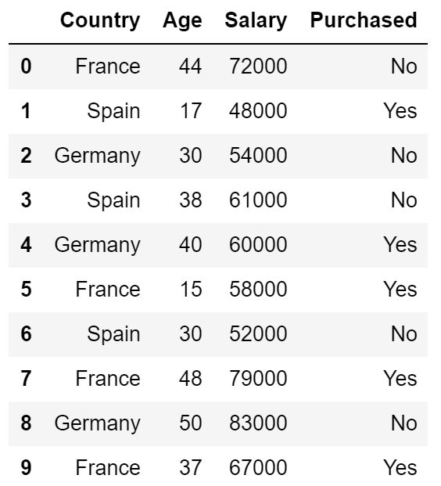
Feature Binarization
Feature binarization is the process of thresholding numerical features to get Boolean values.

Slide 3
K-Bins-Discretization
K-Bins-Discretization is the process of thresholding numerical features to get Numeric values.

Slide 4
Website : www.aisciences.io

